Slide 1
OPTIMA ACADEMY ONLINE · 3RD GRADE SCIENCE
Investigation: Seed vs. Spore Sorting
Lesson 21.02 · Week 21 · NGSS 3-LS1-1
Notes:
Today's investigation is a classification lab, applying 21.01's seed/spore distinction using real evidence-based sorting.

Slide 2
OUR BIG QUESTION
Think About This...
"How can you tell whether a tiny plant part is a seed or a spore?"
Hold this in mind. By the end, answer it with evidence from your own sorting lab.
Notes:
This is answered today through a hands-on classification exercise with six real plant clues.

Slide 3
OBJECTIVES
I Can Statements
I can sort plant clues as seeds or spores using evidence from my observations.
1
I can explain how seeds and spores are alike and how they are different.
2
I can describe a pattern I notice in how seeds and spores help plants reproduce.
3
Notes:
Readiness map: I Can #1 (sort with evidence) -> Plant Clues A-F, sorting chart, Self-Check Q2-3. I Can #2 (alike/different) -> seed vs spore diagram, Self-Check Q1. I Can #3 (pattern) -> Step 4 pattern sentence, Write & Explain.

Slide 4
YOU'LL NEED
Gather Your Materials
Science notebook
Pencil & colored pencils
Magnifying glass (if available)
Notes:
A magnifying glass is optional but helps students appreciate how tiny real spores are.

Slide 5
WARM-UP
What Do You Already Know?
Imagine you're outside and you find two tiny things on the ground. One came from inside an apple. The other is dusty powder on the underside of a fern leaf. They are both incredibly small, and both have something to do with making new plants.
WHAT DO YOU NOTICE? WHAT DO YOU WONDER?
Write 3 things you notice or wonder about seeds and spores. Then write 1 question you hope to answer today.
Notes:
No wrong answers here — we'll come back to your question at the end of the lesson.

Slide 6
KEY VOCABULARY
Seeds, Spores, and Classifying
seed
A plant part that can grow into a new plant. Seeds have a protective coat and a tiny embryo inside.
spore
A single tiny cell that can grow into a new plant, much smaller than a seed.
classify
To sort things into groups based on what they have in common.
Notes:
Classify is the new skill word for this lesson — the entire investigation is a classification lab.

Slide 7
KEY VOCABULARY
Reproducing with Evidence and Patterns
reproduce
To make new living things of the same kind. Every plant reproduces so its species can keep on living.
evidence
Information you observe or measure that supports an explanation. Good scientists always use evidence before drawing a conclusion.
pattern
Something that repeats or appears the same way across different examples. Patterns help scientists make predictions.
Notes:
Evidence and pattern are the two words driving the entire sorting-lab methodology today.

Slide 8
COPY THIS DOWN
Notebook Entry
COPY CAREFULLY INTO YOUR SCIENCE NOTEBOOK
"Both seeds and spores help plants reproduce, but they are not the same."
Notes:
This previews the whole lesson's alike-but-different framing before Sections 1-3.

Slide 9
SECTION 1
Some Plants Use Seeds
Many plants reproduce using seeds. A seed holds a tiny embryo — the beginning of a new plant — protected inside a tough outer coat. Seeds come from flowers, fruits, and cones. After they form, they travel: some ride on wind, some float on water, some stick to passing animals.
WHAT DO YOU NOTICE? WHAT DO YOU WONDER?
Why might it help a seed to travel far away from the parent plant before it starts growing?
Notes:
This directly connects back to 21.01's seed dispersal content.

Slide 10
SECTION 2
Some Plants Use Spores
Ferns, mosses, and some other plants never make seeds. Instead, they reproduce with spores — a spore is just one tiny cell, far smaller than any seed. You often can't see spores without a magnifying glass. Spores form in small clusters on the underside of fern leaves, then drift through air or water.
WHAT DO YOU NOTICE? WHAT DO YOU WONDER?
If spores are so tiny, what do you think happens to most of them after they drift away?
Notes:
The 'far smaller than any seed' size contrast is the single most important clue students will use in the sorting lab.

Slide 11
SECTION 3
Scientists Classify with Evidence
How do scientists tell seeds and spores apart? They look at evidence: size, where it came from, whether it has a coat. Sometimes there isn't enough evidence to be sure — scientists write 'not enough information' rather than guess. It's more honest, and more useful.
REAL-WORLD CONNECTION
Botanists sort and classify plant parts every time they discover a new species.
Notes:
This 'not enough evidence' option is a critical third choice students will use in today's sorting lab, alongside seed and spore.

Slide 12
SEED VS. SPORE
Size and Structure Compared
SEED
SPORE
Has a seed coat
Has an embryo and a hilum
About 1 cm wide
Scattered individually
No protective coat
Just one tiny cell
0.05 mm or less
Forms in a cluster
BOTH help plants reproduce
Notes:
Tap a zone to explore it — in the live Canvas lesson this is interactive; here we present the full side-by-side comparison.

Slide 13
KEY CONCEPT
Say It Before We Show It
KEY CONCEPT
Seeds and spores both help plants reproduce. But a seed carries a protected embryo and stored food inside a coat, while a spore is just one tiny cell with no protective layer. Their size, structure, and source are what scientists use to tell them apart.
Notes:
Have the class restate this together before the Amazing Fact.

Slide 14
AMAZING NATURE FACT
Over One Million Spores
A single fern plant can release over one million spores in a single growing season — and most of them never become a new plant. It takes that many tries to get a few to land just right.
SCIENTIST TALK
Ferns have been reproducing with spores for hundreds of millions of years, even before flowers existed. Why do you think flowering plants eventually became the most common plants on Earth?
Notes:
Go Deeper: flowering plants wrap their embryo in fruit or a seed coat and partner with animals and wind — a newer, very effective strategy.

Slide 15
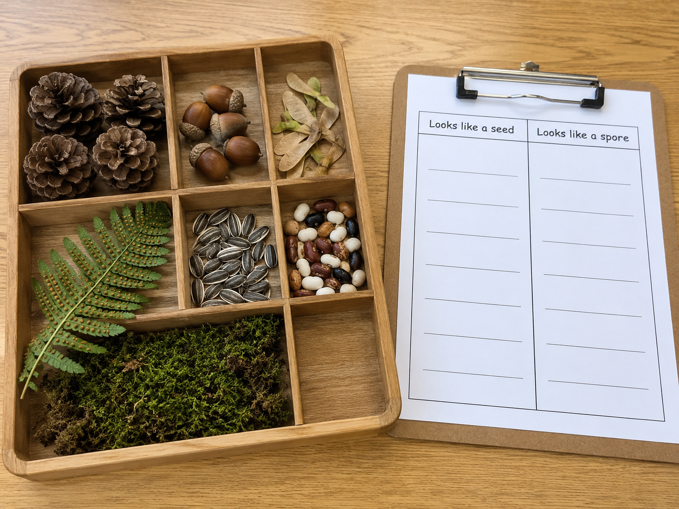
PLANT CLUE SORTING LAB · 15 MIN
This Is What a Real Sorting Lab Looks Like
A wooden sorting tray holds pine cones, acorns, maple samaras, a fern frond with sori, sunflower seeds, bean seeds, and green moss.
Notes:
Notice the different sizes, shapes, and textures. What's the first thing you notice?

Slide 16
PLANT CLUES · A THROUGH F
Read Each Clue Carefully
Clue A: Found inside an apple, surrounded by soft fruit.
Clue B: A fine brown powder on the underside of a fern leaf.
Clue C: Has a hard protective outer coat, about the size of an apple seed.
Clue D: Comes from moss, too small to see without a magnifying glass.
Clue E: Falls from between the scales of a pine cone when it dries out.
Clue F: A flat green leaf attached to a plant stem.
Notes:
For each clue: seed, spore, or not enough evidence? Record your thinking in the chart.

Slide 17
STEPS 1-3
Read, Write Evidence, Sort
CHAT
For each clue, write what you observe in the middle column — size, source, coating. Then write your classification in the last column: seed, spore, or not enough evidence. Use your evidence, not just a guess.
SCIENTIST TALK
Clue F is a green leaf. Why is it harder to classify than the other clues — and what does that tell you about good scientific evidence?
Notes:
REHEARSAL 1 — building the three-column evidence chart for all six clues, exactly the reasoning students will formalize in Part A.

Slide 18
STEP 4
Find a Pattern
CHAT
Look across all your clues. Write one sentence in your notebook describing a pattern you notice — something that most seeds share, or something that made the spore clues different.
Notes:
REHEARSAL 2 of today's reasoning — this pattern-finding step directly previews the Write & Explain question about the biggest difference.

Slide 19
RECORD YOUR THINKING
Organize What You Found
Which clues did you classify as seeds? Which as spores? List them and name the evidence that helped you decide.
Which clue was the hardest to classify? Write one sentence explaining why it was difficult.
Draw what you imagine a seed looks like and what a spore cluster looks like. Label at least 2 parts on each.
Notes:
A good scientist thinks carefully about what they observed — not just 'it was a seed' but WHY they think so.

Slide 20
DISCUSSION
Think It Through
SCIENTIST TALK
What evidence did most of your seed clues have in common? Did any pattern surprise you?
What made the spore clues different from the seed clues? What specific evidence pointed you in that direction?
Why is it important for scientists to write 'not enough evidence' instead of guessing? What could go wrong if they guessed?
Notes:
A fourth question (Extend Your Thinking — inventing a challenging new plant clue) exists in the source lesson, reserved for extension/enrichment if time allows.

Slide 21
QUICK SELF-CHECK 1 OF 3
What do seeds and spores both help plants do?
What do seeds and spores both help plants do?
A) Grow roots underground
B) Reproduce — make new plants of the same kind
C) Absorb water from the soil
WHAT DO YOU NOTICE? WHAT DO YOU WONDER?
What do you notice in this scenario that helps you decide? What do you wonder about before you answer?
CHAT
Why would a plant make seeds or spores in the first place?
Notes:
Direct review of Section 1-2 and I Can #2.

Slide 22
QUICK SELF-CHECK 1 OF 3
What do seeds and spores both help plants do? — Answer
Correct: B — Both seeds and spores are how plants pass life on to the next generation; they just do it in different ways.
Notes:
Think about the main job of both seeds and spores.

Slide 23
QUICK SELF-CHECK 2 OF 3
Fine powdery dust on a fern leaf
A scientist finds fine powdery dust on the underside of a fern leaf. This is most likely —
A) Spores — ferns reproduce with tiny dusty spores, not seeds
B) Seeds — ferns keep their seeds on their leaves
C) Pollen from a nearby flower
WHAT DO YOU NOTICE? WHAT DO YOU WONDER?
What do you notice in this scenario that helps you decide? What do you wonder about before you answer?
CHAT
Do ferns make seeds at all?
Notes:
Direct review of Section 2 and I Can #1.

Slide 24
QUICK SELF-CHECK 2 OF 3
Fine powdery dust on a fern leaf — Answer
Correct: A — Ferns don't make seeds at all. That dusty powder is spores — it's how ferns have reproduced for hundreds of millions of years.
Notes:
Remember, ferns are one of the plants that reproduce with spores, not seeds — think about where the powder comes from and how small it is.

Slide 25
QUICK SELF-CHECK 3 OF 3
Why was Clue F classified as "not enough evidence"?
Why did scientists classify Clue F (a green leaf) as "not enough evidence"?
A) Because leaves are always seeds
B) Because leaves are too large to be plant clues
C) Because a leaf by itself doesn't tell us how that plant reproduces
WHAT DO YOU NOTICE? WHAT DO YOU WONDER?
What do you notice in this scenario that helps you decide? What do you wonder about before you answer?
CHAT
What were we actually trying to classify — plant parts in general, or reproduction clues?
Notes:
Direct review of Section 3 and I Can #1.

Slide 26
QUICK SELF-CHECK 3 OF 3
Why was Clue F classified as "not enough evidence"? — Answer
Correct: C — We were classifying reproduction parts, not plant parts in general. A leaf doesn't give us evidence about seeds or spores.
Notes:
Think about what we were trying to classify — clues about how plants reproduce. Does a leaf give you that information?

Slide 27
ASSIGNMENT · PART A
Sort & Identify
1. List the clues you sorted as seeds and write one piece of evidence for each.
2. List the clues you sorted as spores and write one piece of evidence for each.
3. Which clue got 'not enough evidence'? Explain what additional information you would need.
Notes:
This directly reuses the sorting chart completed during the Explore investigation.

Slide 28
ASSIGNMENT · PART B
Short Answer
4. How are seeds and spores alike? Name at least one thing they have in common.
5. How are seeds and spores different? Name at least two differences.
6. Why is it important to use evidence before classifying something, instead of just guessing?
Notes:
Q4-5 directly reuse the seed vs. spore comparison diagram from the lesson.

Slide 29
ASSIGNMENT · WRITE & EXPLAIN
The Biggest Difference
What is the biggest difference between seeds and spores, and how does that difference matter for the plant?
What do you think?
"I think the biggest difference is…"
What supports your thinking?
"I know this because during the sorting lab, I observed…"
Why does that make sense?
"This makes sense because…"
Try to use at least one of these words: seed, spore, classify, evidence, reproduce
Notes:
REHEARSAL 3 — same pattern-finding structure as Step 4 of the investigation, now written formally with full vocabulary requirements.

Slide 30
ASSIGNMENT · PART C
Draw & Label + Turn It In
Draw a seed and a spore cluster side by side. Label at least 4 parts total across both drawings (for example: seed coat, embryo, hilum, spore, cluster, scattered).
MAKE SURE YOUR SUBMISSION INCLUDES
My completed sorting chart with evidence for each clue (A-F)
My Write & Explain response using science vocabulary
My Part C drawing with seed and spore, labeled with at least 4 parts
Notes:
Remind students: Type It, Photo It, or Record It on Canvas. Before today, did you know some plants never make seeds? What surprised you most?

Slide 31
Great Sorting Work, Plant Scientist!
Next up — how do humans affect ecosystems?
Optima Academy Online · 3rd Grade Science · Lesson 21.02 · NGSS 3-LS1-1 · CPALMS SC.3.L.15.2
Notes:
Preview 22.01 — How Do Humans Affect Ecosystems (Unit 8 begins).

